Slide 1

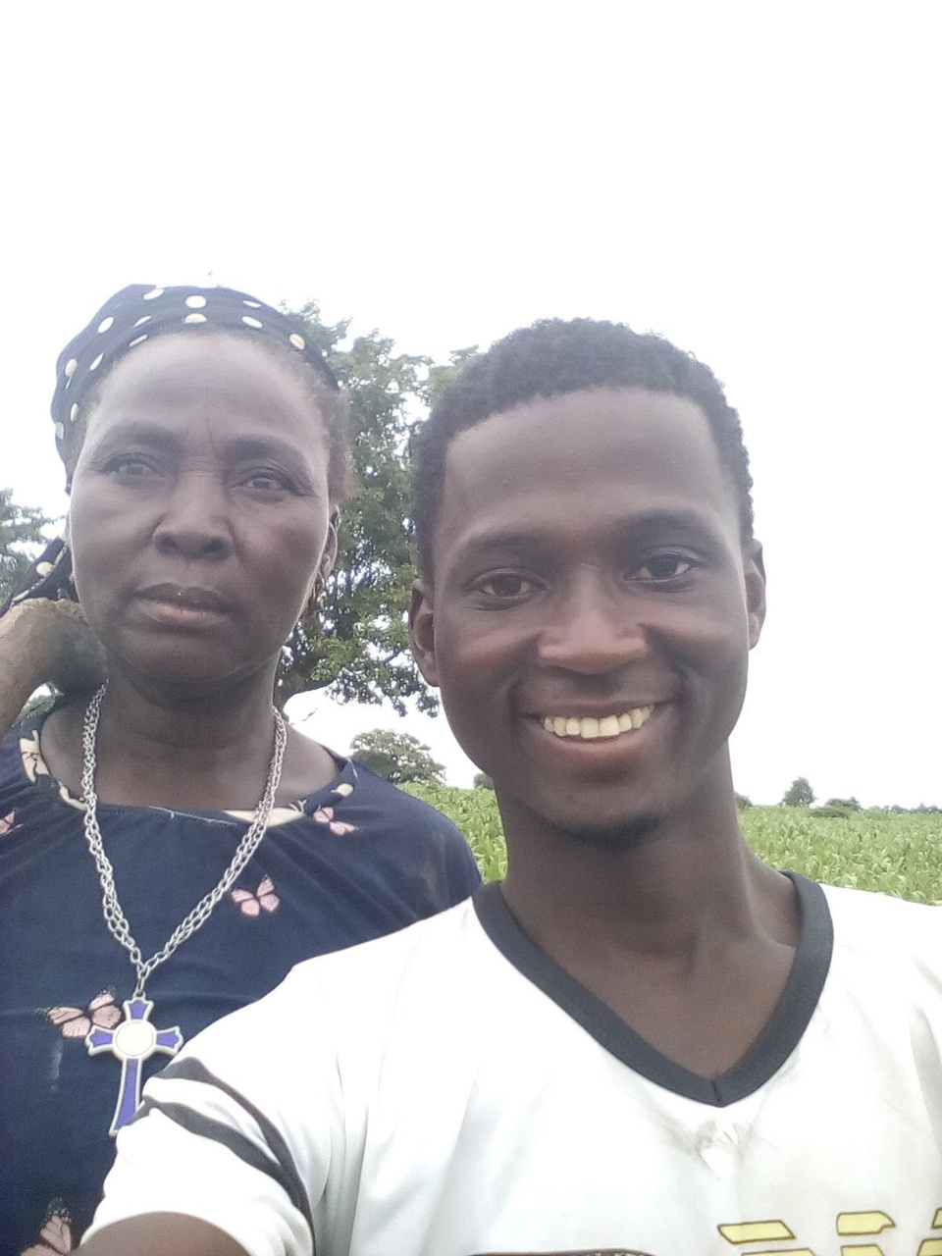

VATKA NIG.LTD
EMPOWERING THE FIELDS, EMPOWERING LIVES:
UNLEASHING THE POTENTIAL OF AGRICULTURE AND WOMEN FARMERS

Slide 2
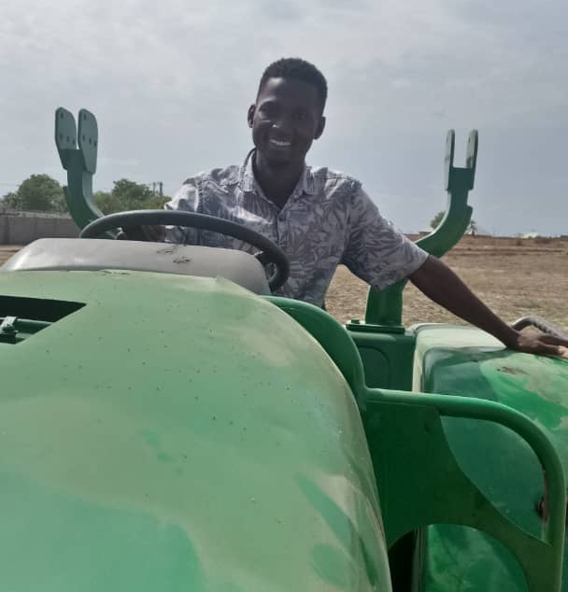
INTRO2VATKA
Vatka Nig. Ltd is a pioneering agricultural company dedicated to the production of organic oils and foods in Nigeria. Our core mission extends beyond commercial success, as we are driven by a profound social mandate to empower women farmers and create a sustainable agricultural ecosystem.

Slide 3
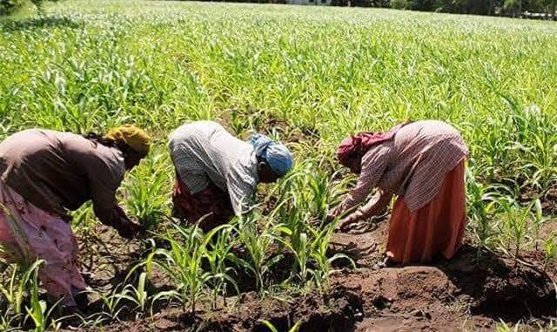
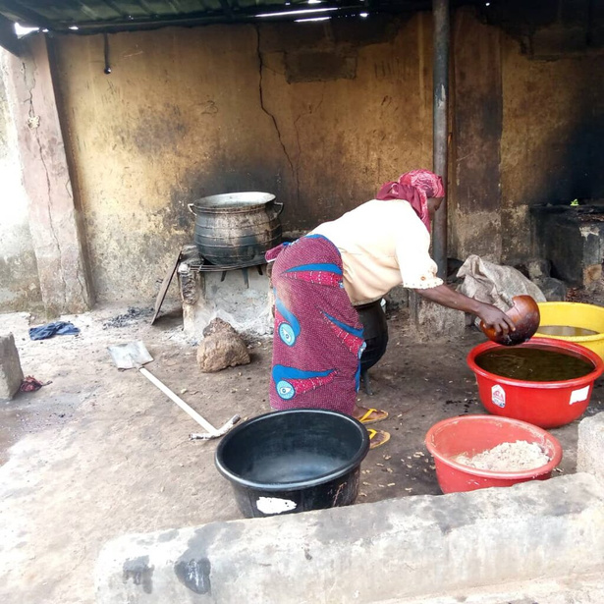
The estimated number of women farmers in Northern Nigeria is approximately 4.5 million. These women play a crucial role in agricultural production, contributing significantly to food security and economic development in the region. However, they often face numerous challenges, including limited access to resources, land tenure insecurity, and gender-based inequalities. Empowering and supporting these women farmers is essential for sustainable agricultural development and the overall well-being of rural communities in Northern Nigeria.
Nigeria, a prominent shea nuts producer in Africa, plays a significant role in the shea butter industry, as highlighted by the United Nations Development Programme (UNDP). The UNDP's research indicates that approximately three million women across Africa are engaged in shea butter-related activities, either directly or indirectly.

Slide 4
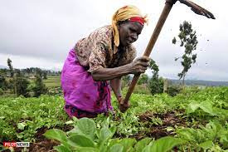
The pain experienced by women using hand tools and manual labor to farm and produce organic oils is both physical and emotional. Physically, the repetitive and strenuous nature of manual labor can lead to muscle strains, joint pain, and fatigue. Women often have to endure long hours of bending, lifting, and carrying heavy loads, which can take a toll on their bodies.
Moreover, the lack of proper tools and equipment increases the difficulty and inefficiency of their work. Women may have to rely on rudimentary tools like hoes and machetes, which require significant physical exertion and can cause blisters and calluses on their hands. The absence of mechanized machinery adds to their burden, forcing them to rely solely on their physical strength.

Slide 5
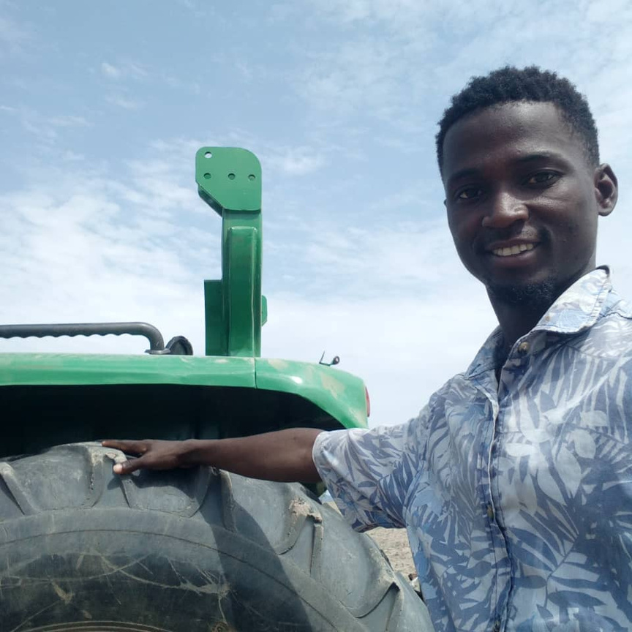
VATKA TO THE RESCUE
With our medium-sized tractor with appropriate attachments typically cover between 2 to 4 hectares of land in 4 hours, assuming favorable working conditions and relatively straightforward tasks like plowing or harrowing. We help these women cultivate their farm lands, buy their farm produces and make sure they're paid living wages.

Slide 6
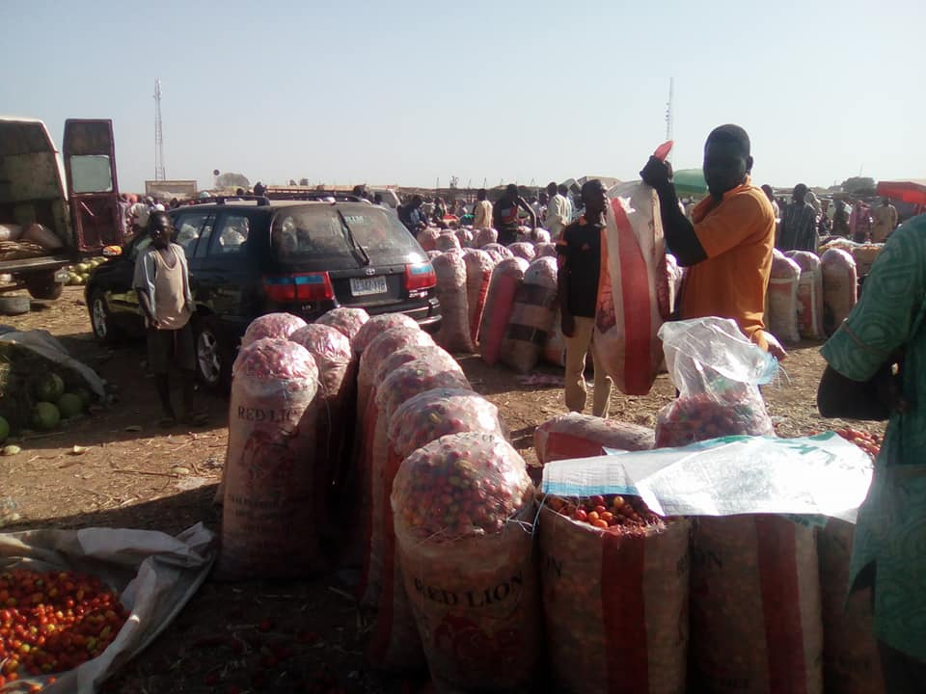
ACCESS TO MARKET
Vatka Nig. Ltd has established partnerships and collaborations with local and international buyers, distributors, and retailers to create direct market channels for women farmers. This ensures that their organic oils and products reach a wider customer base.

Slide 7
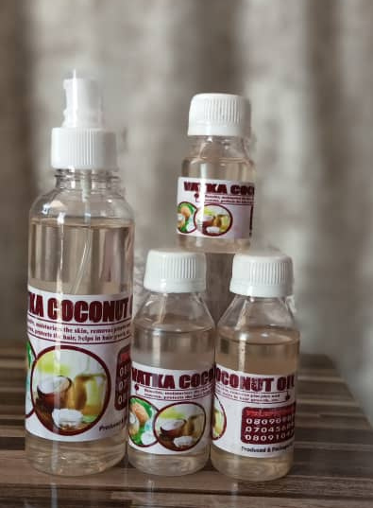
Value-Added Processing
By providing training and resources, Vatka Nig. Ltd supports women farmers in adding value to their products through processing and packaging. This enables them to offer unique and marketable products that fetch higher prices and attract a broader consumer base.

Slide 8
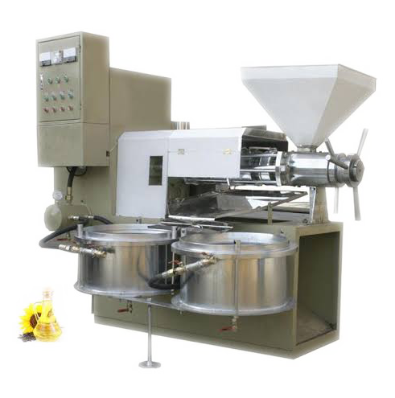
Empowering Women Farmers through Oil Extraction Machine
By utilizing our oil extraction machine, women farmers can significantly increase their productivity and output. They no longer have to rely solely on traditional and time-consuming methods, such as manual pressing or grinding, which are labor-intensive and yield limited quantities of oil.

Slide 9
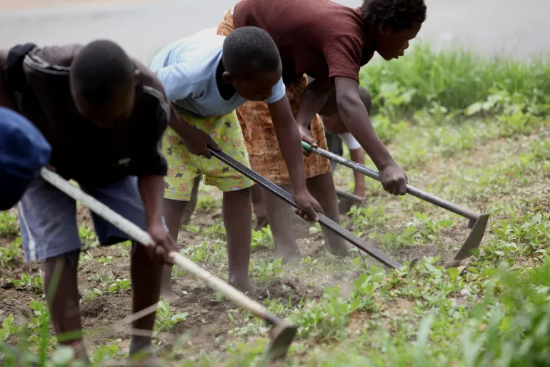
Conclusion
By providing women farmers with access to our oil extraction machine, we are not only empowering them to enhance their production capabilities but also enabling them to generate higher incomes and improve their livelihoods.

Slide 10
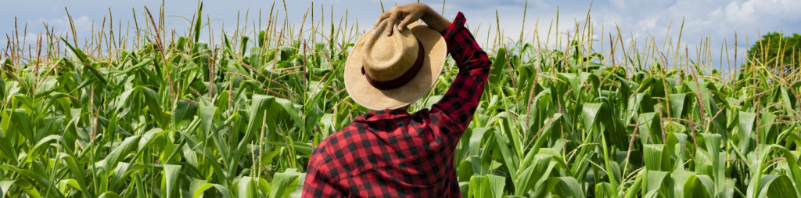
Thank You
VATKA NIG. LTD
3B OGUN STREET AREA 2 GARKI ABUJA
Join us on this journey as we cultivate a future where women farmers flourish, communities thrive, and the impact reverberates far beyond the fields. Together, we can sow the seeds of change and harvest a world of possibilities.

